Slide 1
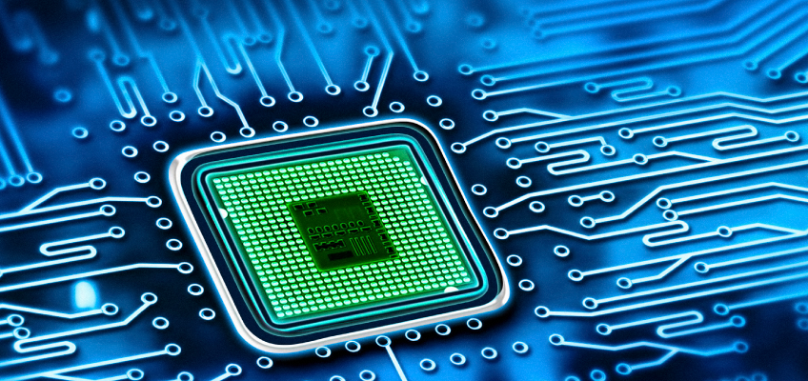
Sensor and Sensing Technology
Presenting to
Professor Zhang, Yikui
School Computer Software

Slide 2
Name & ID | Taiabur Rahman 6218000126 | Mansoor Saleh Mubarak Bamahel 6218000158 | Mohammed Hasan mohammed algamali 6118000082
Part | Radiometry | Lenses | Concentrators
 | Photometry | Fresnel Lenses | Coatings for Thermal Absorption
 | Windows | Fiber Optics and Waveguides | Nano-opticsn
 | Mirrors

Slide 3
Optical Components of Sensors
Presentation topic

Slide 4
Radiometry
Photometry
Windows
Mirrors

Slide 5
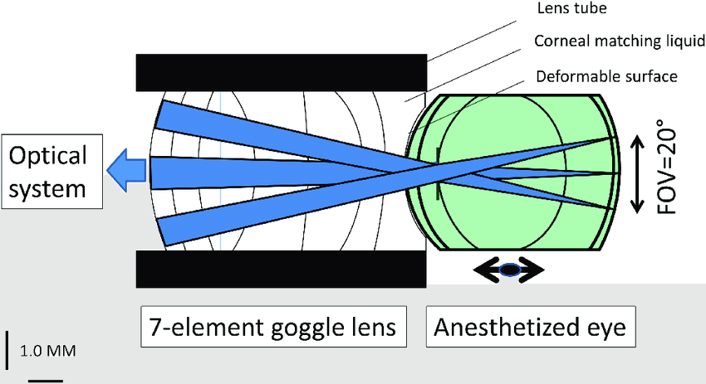
Optical Components of Sensors
The light direction can be changed by the refraction with the help of lenses, prisms, windows, chemical solutions, crystals, organic materials, and biological objects. While passing through these objects, properties of light may be modified (modulated) by a measured stimulus. Then, the task of a sensor designer is to arrange a conversion
Image source: internet

Slide 6


Optical System
A double concave lens is thinner and flatter in the middle than the edges.
Light passing through the thicker more curved areas of the lens will bend more than light passing through the thinner areas, causing the light to spread out or diverge.
The formation of an image with a double convex lens depends on where the object is placed and the orientation of the light source.
Image source: internet

Slide 7
Radiometry
What is Radiometry?
Radiometry is detecting and measuring electro-magnetic energy (radiant energy).
What are Radiometric Measurements?
Radiometric measurements use the electromagnetic energy received by a sensor to calculate figures of merit rather than the temperature of an object in the scene.
Why Use Radiometric Measurements?
They more accurately measure a sensor characteristics because a sensor responds to the radiant energy in a scene not the temperature of a single object.
Image source: internet

Slide 8
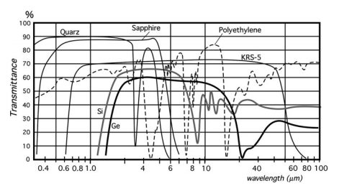
Transparency characteristics for various optical materials
Image source: internet

Slide 9

Photometry
Photometry focuses on assigning numerical values of light energy emitted form wavelengths between 400 and 700nm. This is the visible light portion.
This light meter from Quantum Instruments is just for Photometry use.
Image source: internet

Slide 10
Radiometric and photometric terminology
Description | Radiometric | Photometric
Total flux | Radiant flux (F) in watts | Luminous flux (F) in lumens
Emitted flux density at a source surface | Radiant emittance (W) in W/cm2 | Luminous emittance (L) in Lumens/cm2 (Lamberts)
Source intensity (point source) | Radiant intensity (Ir) in W/steradian | Luminous intensity (IL) in Lumens/steradian (candela)
Source intensity (area source) | Radiance (Br) in W/steradian/cm2 | Luminance (BL) in Lumens/steradian/cm2 (Lambert)
Flux density incident on a receiver surface | Irradiance (H) in W/cm2 | Illuminance (E) in lumens/cm2 (candle)

Slide 11
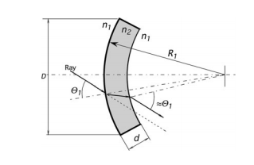
Windows
The main purpose of windows is to protect interiors of sensors and detectors from environment.
A good window should transmit light rays in a specific wavelength range with minimal distortions.
Spherical window

Slide 12
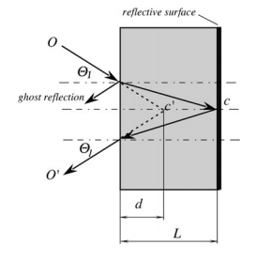
Mirrors
Mirror is the oldest optical instrument ever used or designed.
Whenever light passes from one medium to another, there is some reflection.
Second surface mirror

Slide 13

Thank you

